Slide 1
Which academic discipline has welcomed new papers in terms of citation?
Juyoung An & Yi Bu
School of Informatics and Computing
Indiana University
Notes:
Hi, guys.
I am juyoung An, who is computer scientist and I am Yi bu, who is humanist.
So do you remember the controversy we’ve had last time?
I argued that if I publish a new paper in computer science area, computer scientists will welcome me and cite my paper because they are interested in a new paper.
However, the humanist Yi bu said that they will not be interested in my paper because in his area, scholars do not care about new paper and just cite the papers which have already got many citations. So, we tried to find the winner of this controversy by using preferential attachment of citation network.
If there is strong tendency of preferential attachment in both computer science and humanities areas, Yi bu will be the winner because it means that only the papers highly cited are likely to be cited while the new papers that do not have citation are not likely to be cited.
So, let’s see the work we’ve done to decide the winner!

Slide 2
1. Introduction
Preferential attachment (Barabási & Albert, 1999)
mechanism which rules the growth of a large networks such as genetic networks and the world wide web in reality.
When there is a new vertex added in a network, the vertex attaches preferentially to already well connected vertex.
Preferential attachment has been examined by previous researchers, but only limited domains (not all domains)

Slide 3
1. Introduction
A few of the previous researchers have focused on the preferential attachment in co-authorship networks
Preferential attachment might change during different periods of time
What we want to do: Analyzing the changes of preferential attachment in a long time using the data from multiple domains.

Slide 4
2. Related Work: Preferential attachment in scholarly network
Newman (2001)
Coauthorship network; Physics and biology
Barabási et al. (2002)
Two coauthorship networks; Mathematics and Neuroscience; 8-year period
Zhang et al. (forthcoming)
Coauthorship network; Information Retrieval field; nearly 50 years

Slide 5
2. Related Work: Adapting network theory on citation network
Render (1998)
Exploring Distribution of citation
Medina & Leeuwen (2003)
Using degree of citation network to find important paper in journals.
Radev et al. (2009)
Citation network of Computational Linguistics is explored by using basic measurement in network theory such as Diameter, Average Shortest Path, Power law, and Clustering Coefficient.
Peterson, Presse, & Dill (2010)
Dividing two mechanisms of citation into direct and indirect mechanism, and identified that the difference in degree distributions between the network built upon different mechanism
Notes:
Numerical data for the distribution of citations are examined for: (i) papers published in 1981
in journals which are catalogued by the Institute for Scienti c Information (783,339 papers) and (ii) 20
years of publications in Physical Review D, vols. 11-50 (24,296 papers). A Zipf plot of the number of
citations to a given paper
versus
its citation rank appears to be consistent with a power-law dependence
for leading rank papers, with exponent close to
−
1
=
2. This, in turn, suggests that the number of papers
with
x
citations,
N
(
x
), has a large-
x
power law decay
N
(
x
)
x
−
,with
3
The study presented here shows a method based on
network theory to identify the most important journals
related to a given journal, the seed journal. In just one
simple network map, we get the relevant citation environ-
ment of a specific seed journal. It is of interest to librar-
ians, publishers, scientists and science policy makers.
These journal citation network maps are useful for these
various stakeholders in and around the science system,
as they provide information on the level of journal con-
nections, unlike the more traditional structures such as
the Journal Subject Categories, the classification system
applied in the products of Thomson Reuters (Journal
Citation Reports, Web of Science, etc.). These network
maps show the closest relations journals can have,
based on citation relations, suggesting influence rela-
tions between journals in such a way that traditional field
boundaries are transcended.
The ACL Anthology is a large collection of research papers in
computational linguistics. Citation data was ob-
tained using text extraction from a collection of PDF files wi
th significant manual post-processing performed
to clean up the results. Manual annotation of the references
was then performed to complete the citation net-
work. We analyzed the networks of paper citations, author ci
tations, and author collaborations in an attempt to
identify the most central papers and authors. Also, we propo
se an improved method for comparing different
measures of impact based on correlation. The analysis inclu
des general network statistics, PageRank, metrics
across publication years and venues, impact factor and h-in
dex, as well as other measures.
We develop a model for the distribution of scientific citations. The
model involves a dual mechanism: in the
direct mechanism
, the
author of a new paper finds an old paper
A
and cites it. In the
indirect mechanism
, the author of a new paper finds an old paper
A
only
via
the reference list of a newer intermediary paper
B
, which
has previously cited
A
. By comparison to citation databases, we
find that papers having few citations are cited mainly by the direct
mechanism. Papers already having many citations (
“
classics
”
) are
cited mainly by the indirect mechanism. The indirect mechanism
gives a power-law tail. The
“
tipping point
”
at which a paper be-
comes a classic is about 25 citations for papers published in the In-
stitute for Scientific Information (ISI) Web of Science database in
1981, 31 for
Physical Review D
papers published from 1975
–
1994,
and 37 for all publications from a list of high
h
-index chemists
assembled in 2007. The power-law exponent is not universal.
Individuals who are highly cited have a systematically smaller ex-
ponent than individuals who are less cited.

Slide 6
2. Related Work: Adapting network theory on citation network
Wang, Yu, & Yu (2008)
Preferential attachment mechanism (PAM) was explored
Dynamic change of preferential attachment in citation networks
Focus more theoretical level but not empirical level
Findings: The past citations obtained in different years will have different influences on papers’ attachment rate

Slide 7
2. Related Work: Adapting network theory on citation network
Jeong, Deda, & Barabasi (2003)
Finding a linear preferential attachment on papers published in 1988 in Physical Review Letters
Wang, Yu & Yu (2009)
Identifying the preferential attachment in actual citation networks to characterize the influences of papers’ age on the attachment property.
Wang, Song, & Barabasi (2013)
Applying preferential attachment to build citation prediction model considering time change
=> Theoretical & limited disciplines or Not dynamic

Slide 8
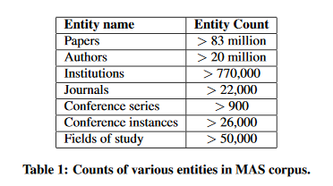
Data Source
Microsoft Academic Graph
~2015.8.20
3. Methods - Data
Arnab et al. (2015)

Slide 9
Data Source
Mapping articles into 13 disciplines
proposed by Börner et al. (2012)
Extracting article ID
Find journal with article ID
Match disciplines with journal name
3. Methods – Data
Biology
Biotechnology
Medical Specialties
Chemical, Mechanical, & Civil Engineering
Chemistry
Earth Sciences
Electrical Engineering & Computer Science
Brain Research
Humanities
Infectious Diseases
Math & Physics
Health Professionals
Social Sciences

Slide 10
Paper
Journal
Sub
Domain
Year
Journal ID
Journal name
Citation Networks of 13 disciplines from 2010 to 2015
Domain
Reference

Slide 11
3. Methods – Data Description
 | The oldest year | # of Citing paper | # of Cited paper
Biology | 1825 | 845,428 | 1,067,256
Biotechnology | 1882 | 332,324 | 415,365
Medical Specialties | 1824 | 2,081,563 | 2,643,059
Chemical, Mechanical, & Civil Engineering | 1800 | 722,694 | 769,853
Chemistry | 1811 | 1,142,035 | 1,624,015
Earth Sciences | 1819 | 290,249 | 328,830
Electrical Engineering & Computer Science | 1900 | 470,868 | 454,866
Brain Research | 1849 | 787,984 | 892,860
Humanities | 1825 | 44,613 | 56,801
Infectious Diseases | 1843 | 808,208 | 1,116,668
Math & Physics | 1821 | 787,165 | 1,080,783
Health Professionals | 1842 | 973,628 | 924,560
Social Sciences | 1827 | 838,967 | 941,709
Notes:
가장 많은 거, 적은거 -> 색으로 표시
Electrical Engineering은 아주 희한하네.. -> 같은 논문이 계속 인용됐다.
The interesting thing is that

Slide 12
Preferential Attachment
3. Methods
* 3 types of Preferential Attachment
One occurs by only new nodes
- Other one occurs by both new and existing nodes
- The other occurs by existing nodes
(Milojević, 2010)
New
There is no connection between existing nodes in citation network
Only in-degree (citing) is considered.
Notes:
Citation에는 새로 들어오는 node만 있음

Slide 13
Preferential Attachment
3. Methods
 | 2010
A | 2
B | 2
C | 1
D | 1
A
B
D
C
Notes:
Let’s assume that

Slide 14
Preferential Attachment
3. Methods
G
 | 2010 | 2011
A | 2 | 4
B | 2 | 3
C | 1 | 1
D | 1 | 1
E |  | 1
F |  | 1
G |  | 1
Average # of new node attached nodes obtaining n degree
1: 0(C)+0(D)/2 = 0
2: 2(A)+1(B)/2 =1.5
The 2011’s PA is log-log plotted as
(1, 0) (2, 1.5)
E
A
B
F
D
C
Notes:
Let’s assume that
The number of new node attached in the nodes which have n degree can be calculated like this.

Slide 15
Preferential Attachment
3. Methods
I
 | 2011 | 2012
A | 4 | 5
B | 3 | 3
C | 1 | 1
D | 1 | 2
E | 1 | 1
F | 1 | 1
G | 1 | 1
H |  | 1
I |  | 1
Average # of new node attached nodes obtaining n degree
1: 0(C)+1(D)+0(E) +0(F)+0(G)/5 = 0.2
3: 0(B)/1 = 0
4: 1(A)/1 = 1
The 2012’s PA is log-log plotted as
(1, 0.2) (3, 0) (4, 1)
G
E
A
B
F
D
C
H
Notes:
Let’s assume that
The number of new node attached in the nodes which have n degree can be calculated like this.

Slide 16
2012
I
G
2011
E
2010
A
B
F
H
D
C
Notes:
Let’s assume that
The number of new node attached in the nodes which have n degree can be calculated like this.

Slide 17
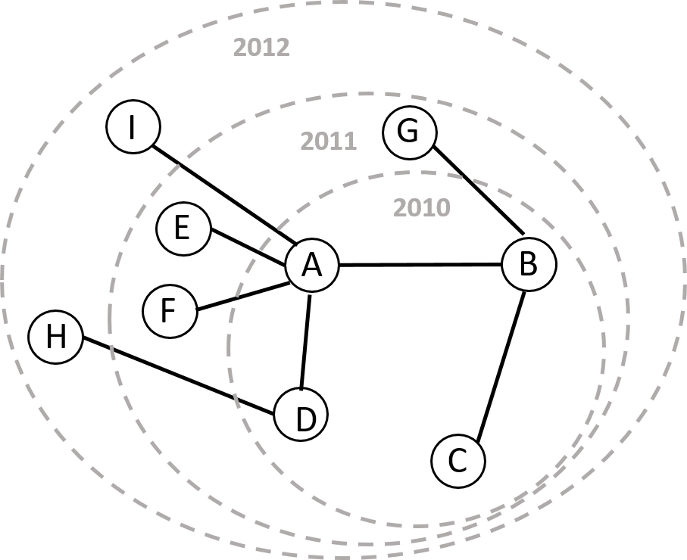
 | 2010 | 2011 |  | 2012
A | 2 | Average number of new nodes attached to nodes obtaining n degree : 1: 0(C)+0(D)/2 = 0 2: 2(A)+1(B)/2 =1.5 For 2011, (1, 0) (2, 1.5) are plotted in log-log plot. | 4 | Average number of new nodes attached to nodes obtaining n degree : 1: 0(C)+1(D)+0(E) +0(F)+0(G)/5 = 0.2 3: 0(B)/1 = 0 4: 1(A)/1 = 1 For 2012, (1, 0.2) (3, 0) (4, 1) are plotted in log-log plot. | 5
B | 2 |  | 3 |  | 3
C | 1 |  | 1 |  | 1
D | 1 |  | 1 |  | 2
E |  |  | 1 |  | 1
F |  |  | 1 |  | 1
G |  |  | 1 |  | 1
H |  |  |  |  | 1
I |  |  |  |  | 1
Notes:
Let’s assume that
The number of new node attached in the nodes which have n degree can be calculated like this.

Slide 18
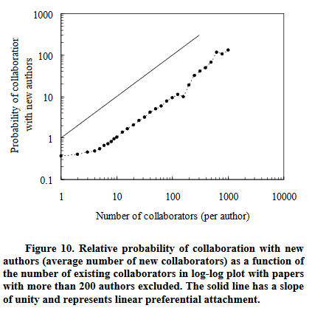
Preferential Attachment
3. Methods
The correlation needs to be linear in order for preferential attachment to produce a power law distribution (Barabási & Albert, 1999). Linear function is represented by a line having a slope of 1.
(Milojević, 2010, p.9.)
Notes:
s

Slide 19
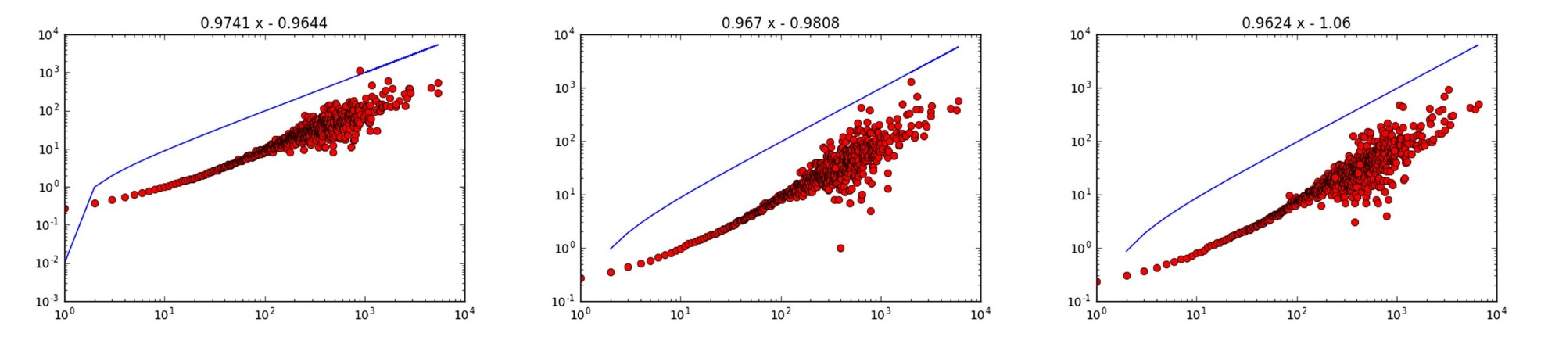
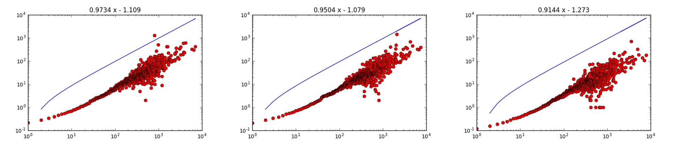
4. Result
Biology
Max:0.974056 (2)
Min.:0.914361 (3)
Avg.: 0.956942 (3)
2010 2011 2012
2013 2014 2015

Slide 20
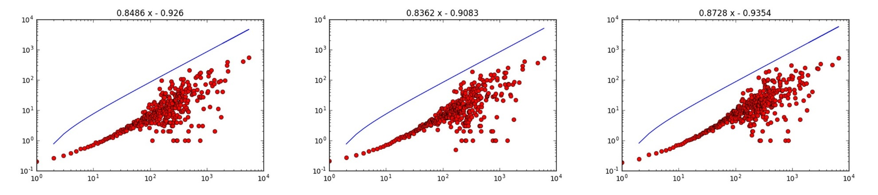
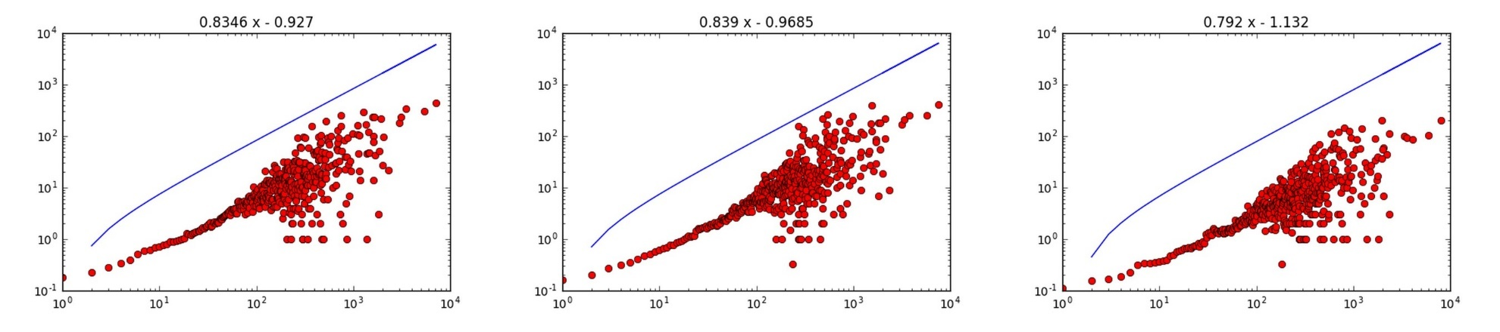
4. Result
Biotechnology
Max:0.872838 (12)
Min.:0.791954 (12)
Avg.: 0.837223 (12)
2010 2011 2012
2013 2014 2015

Slide 21
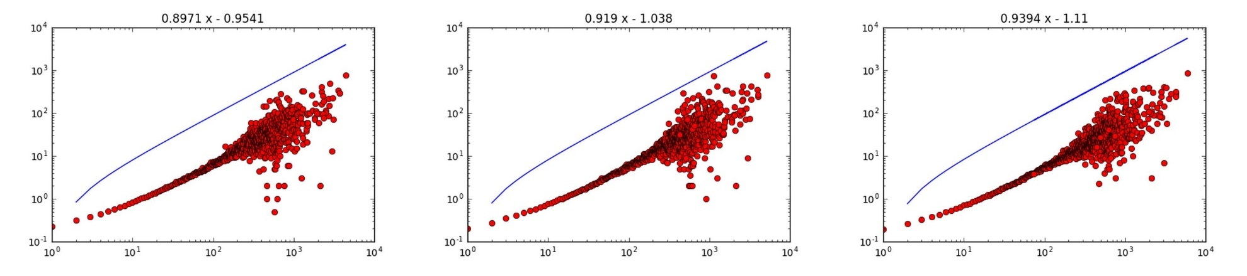
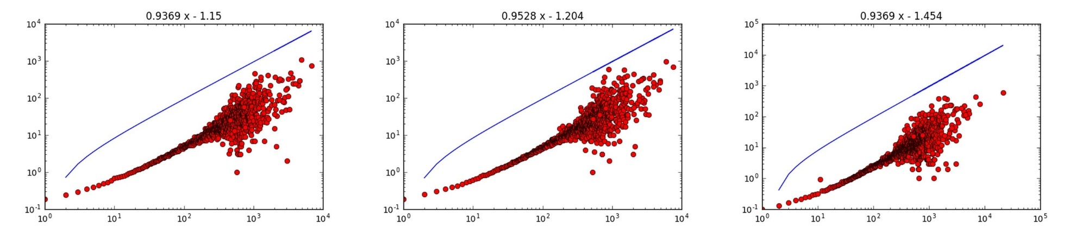
4. Result
Medical Specialties
Max:0.952849 (7)
Min.:0.897082 (5)
Avg.: 0.93035 (6)
2010 2011 2012
2013 2014 2015

Slide 22
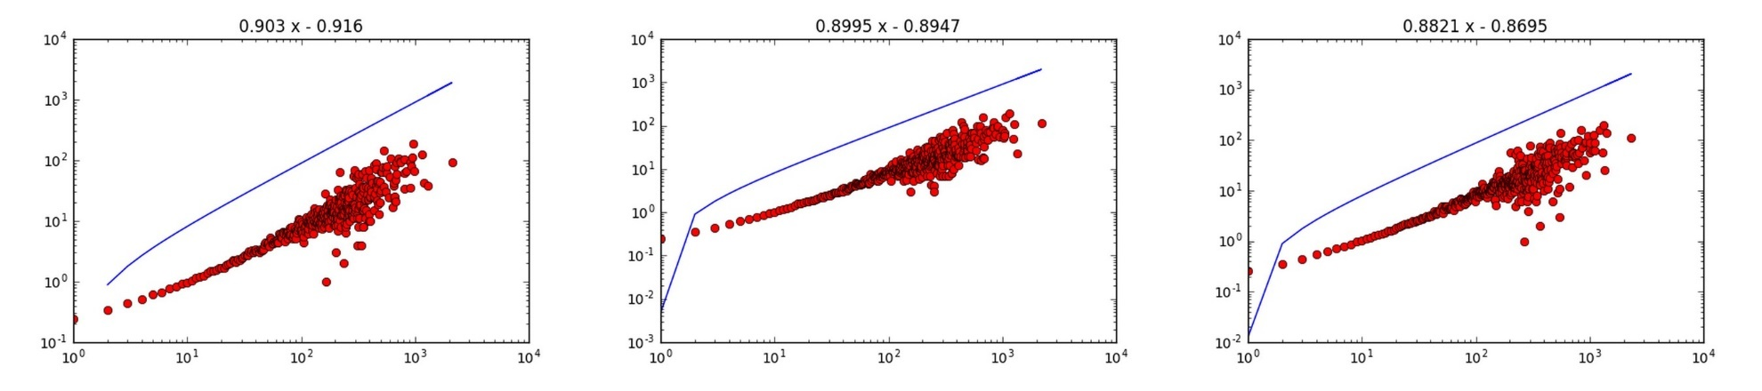
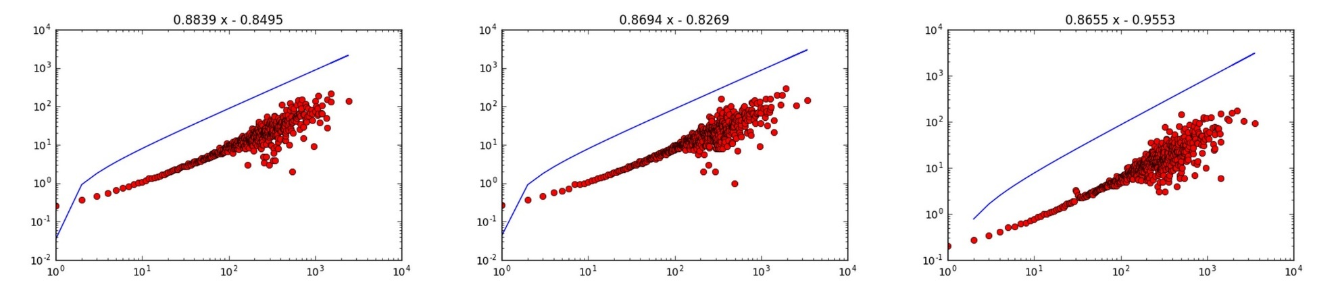
4. Result
Chemical, Mechanical, & Civil Engineering
Max:0.902967 (11)
Min.:0.865482 (8)
Avg.: 0.883899 (10)
2010 2011 2012
2013 2014 2015

Slide 23
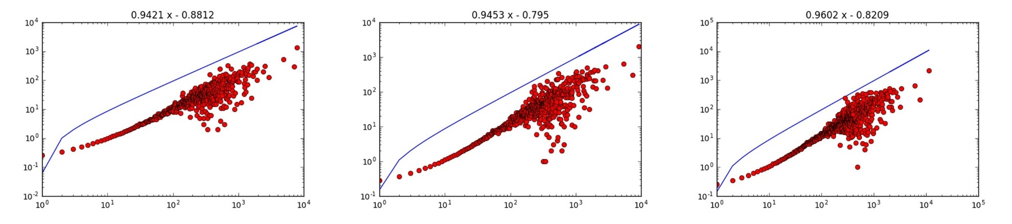
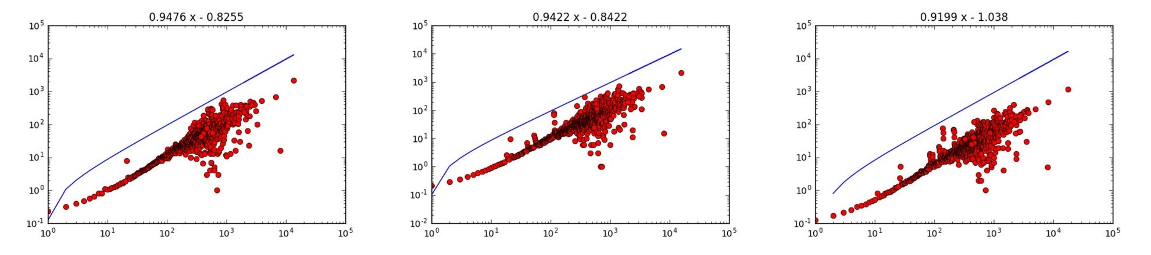
4. Result
Chemistry
Max:0.96017 (5)
Min.:0.919899 (2)
Avg.: 0.942862 (4)
2010 2011 2012
2013 2014 2015

Slide 24
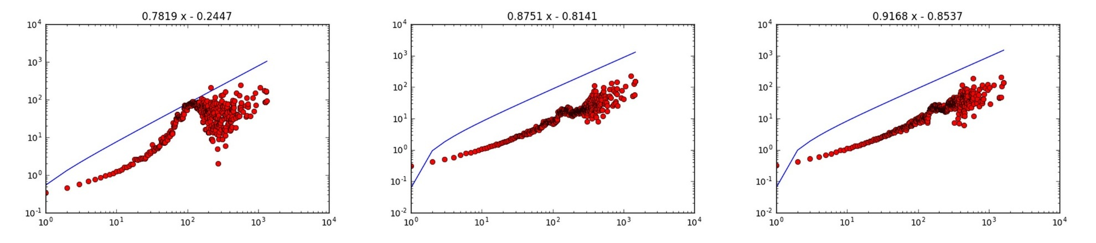
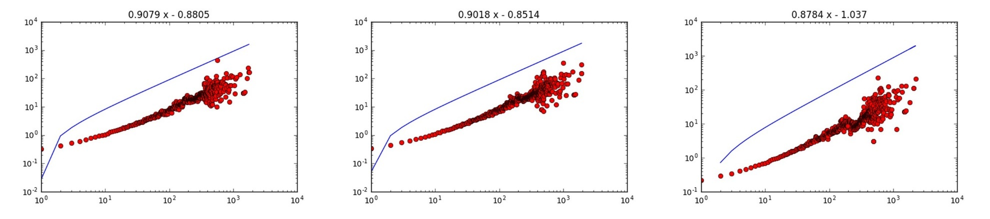
4. Result
Earth Sciences
Max:0.91681 (9)
Min.:0.781855 (13)
Avg.: 0.876991 (11)
2010 2011 2012
2013 2014 2015

Slide 25
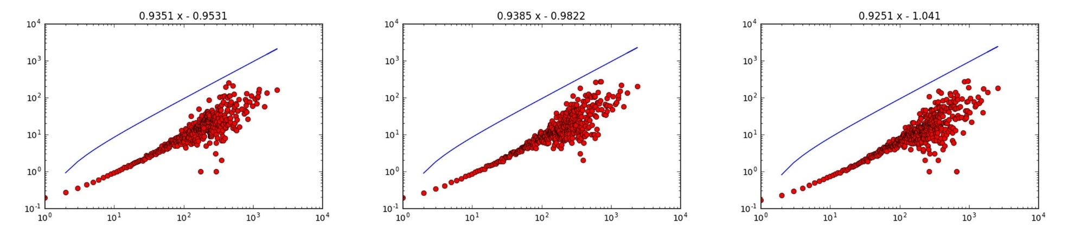
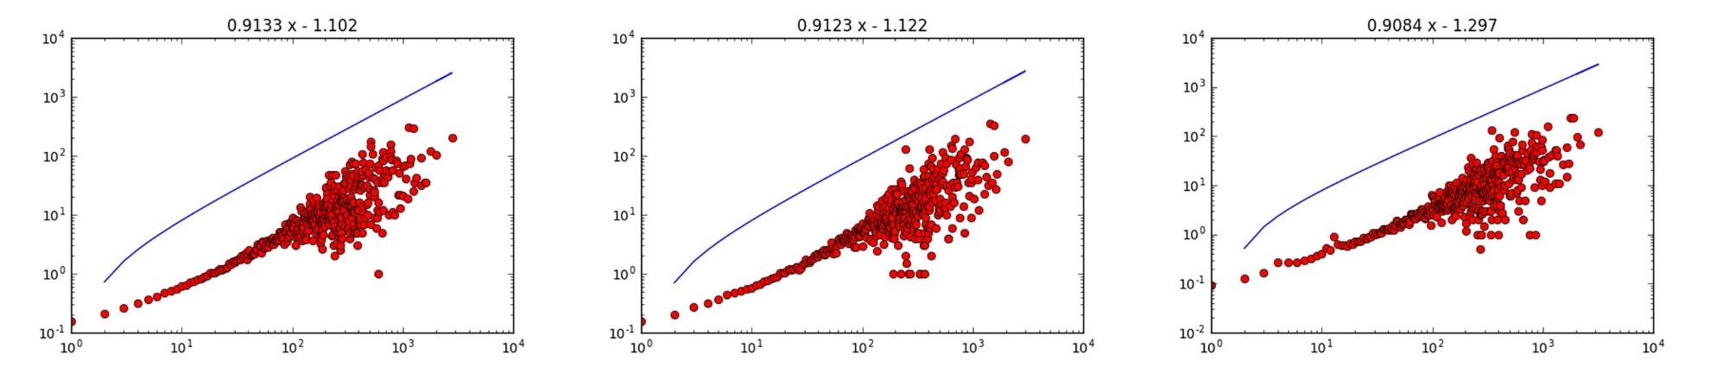
4. Result
Electrical Engineering & Computer Science
Max:0.938529 (8)
Min.:0.908403 (4)
Avg.: 0.922126 (7)
2010 2011 2012
2013 2014 2015

Slide 26
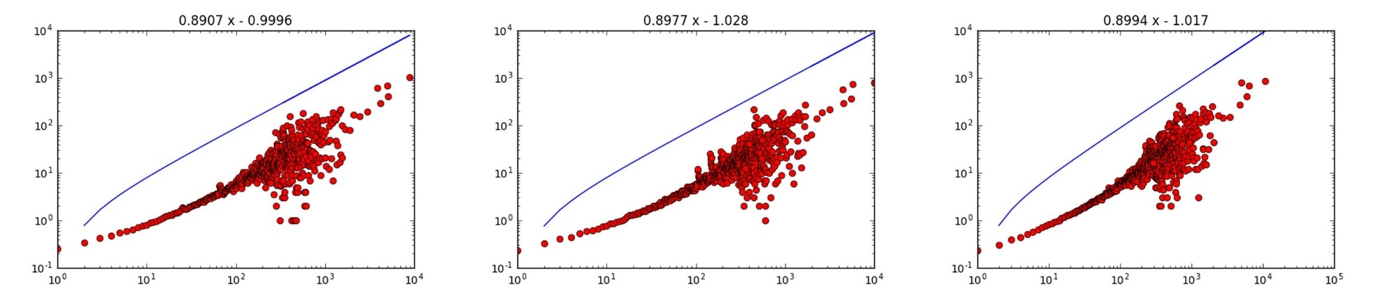
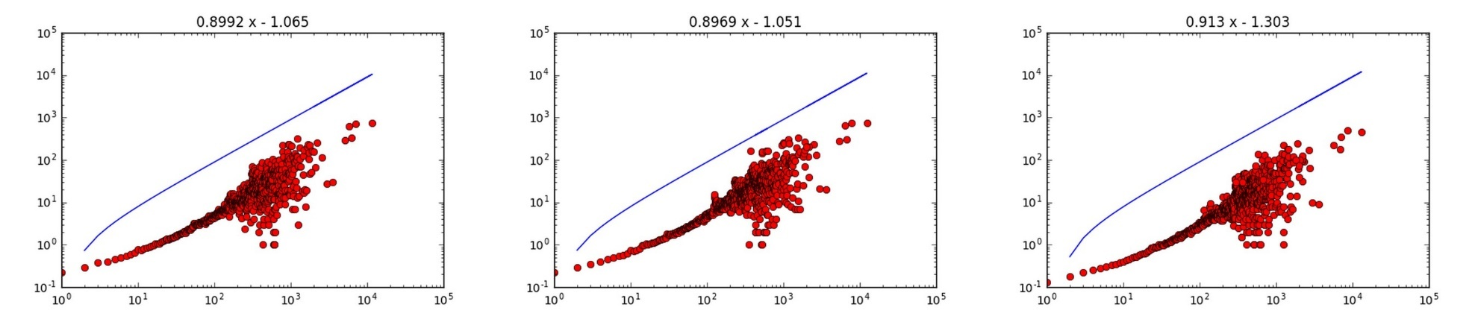
4. Result
Brain Research
Max:0.912962 (10)
Min.:0.890669 (7)
Avg.: 0.956942 (2)
2010 2011 2012
2013 2014 2015

Slide 27
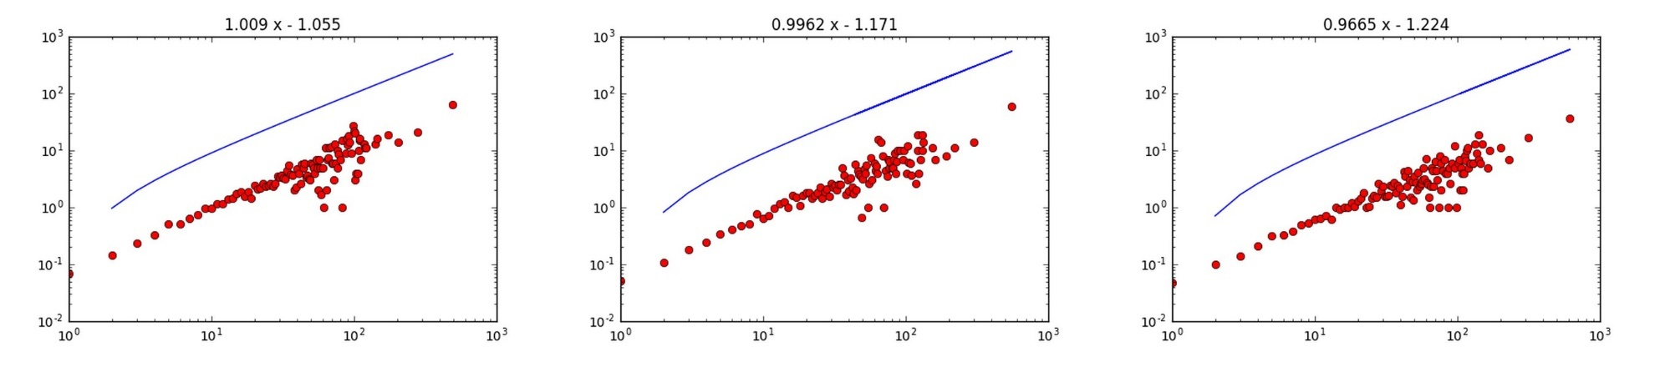
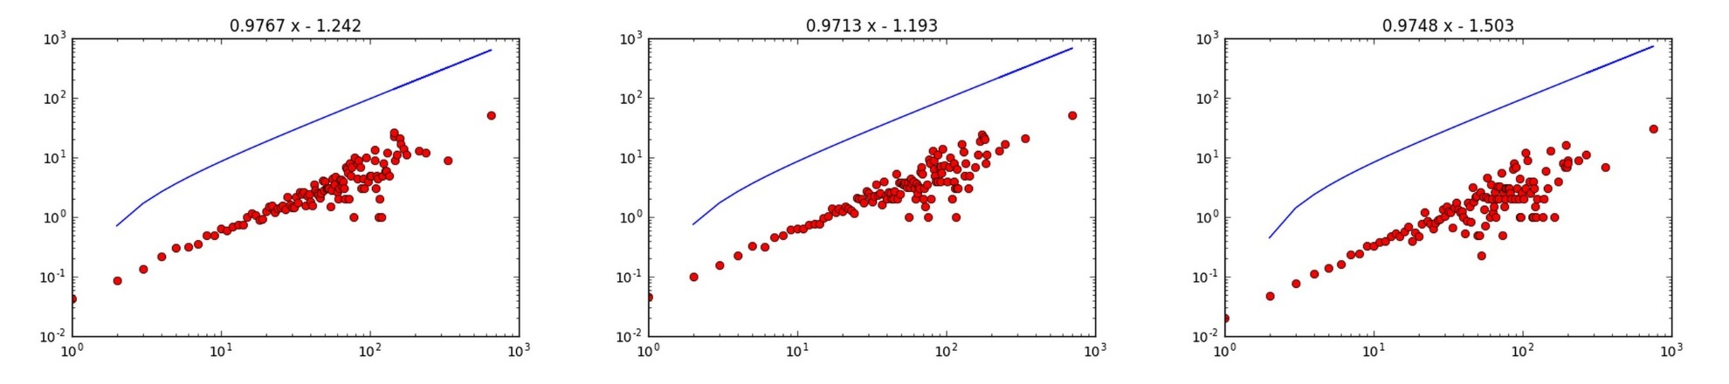
4. Result
Humanities
Max:1.009413 (1)
Min.:0.966462 (1)
Avg.: 0.982481 (1)
2010 2011 2012
2013 2014 2015

Slide 28
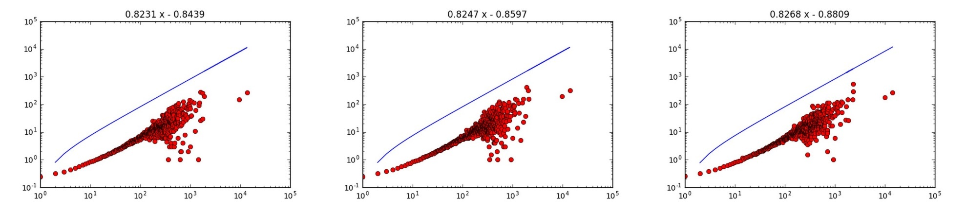
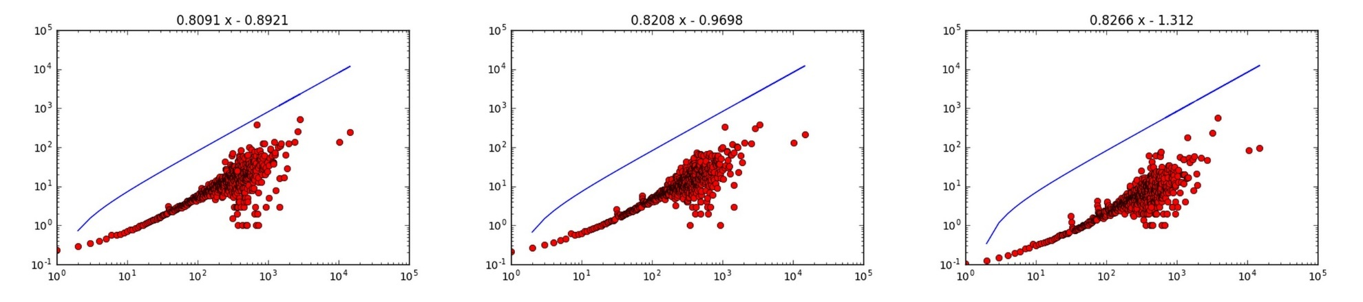
4. Result
Infectious Diseases
Max:0.826846 (13)
Min.:0.809136 (11)
Avg.: 0.821863 (13)
2010 2011 2012
2013 2014 2015

Slide 29
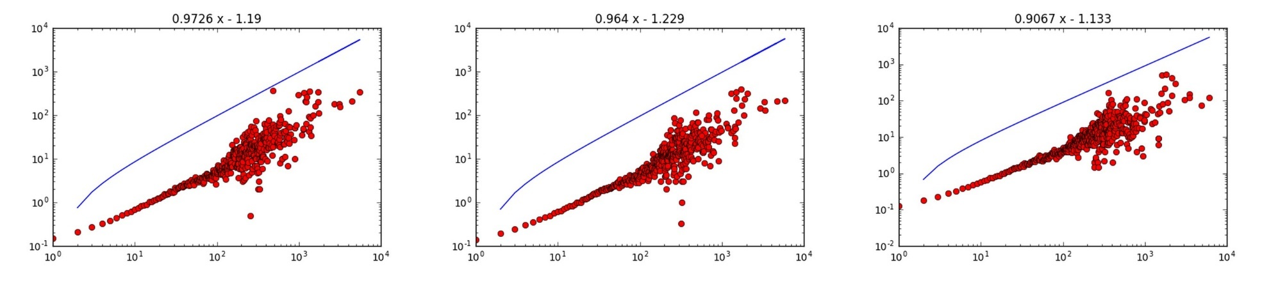
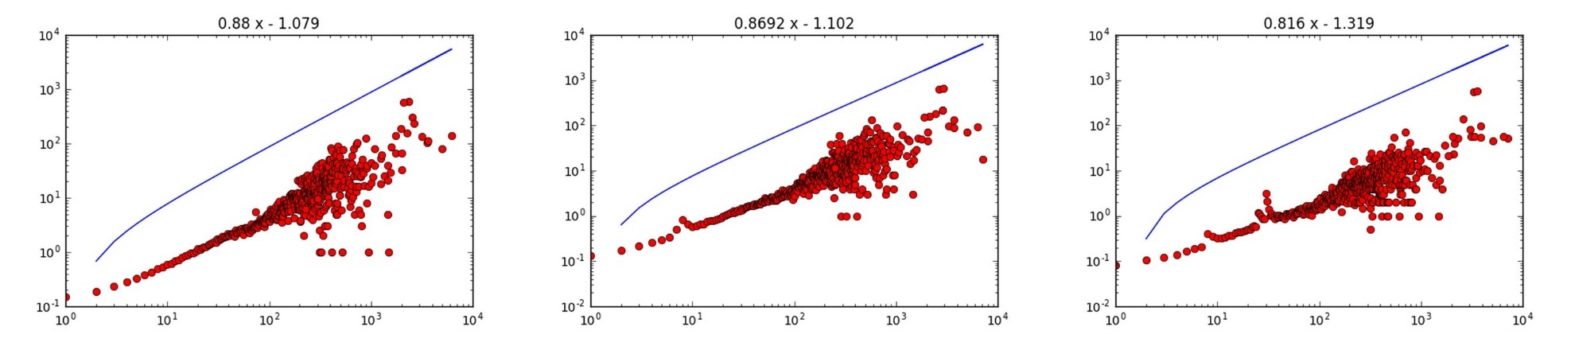
4. Result
Math & Physics
Max:0.972602 (3)
Min.:0.815953 (10)
Avg.: 0.901407 (9)
2010 2011 2012
2013 2014 2015

Slide 30
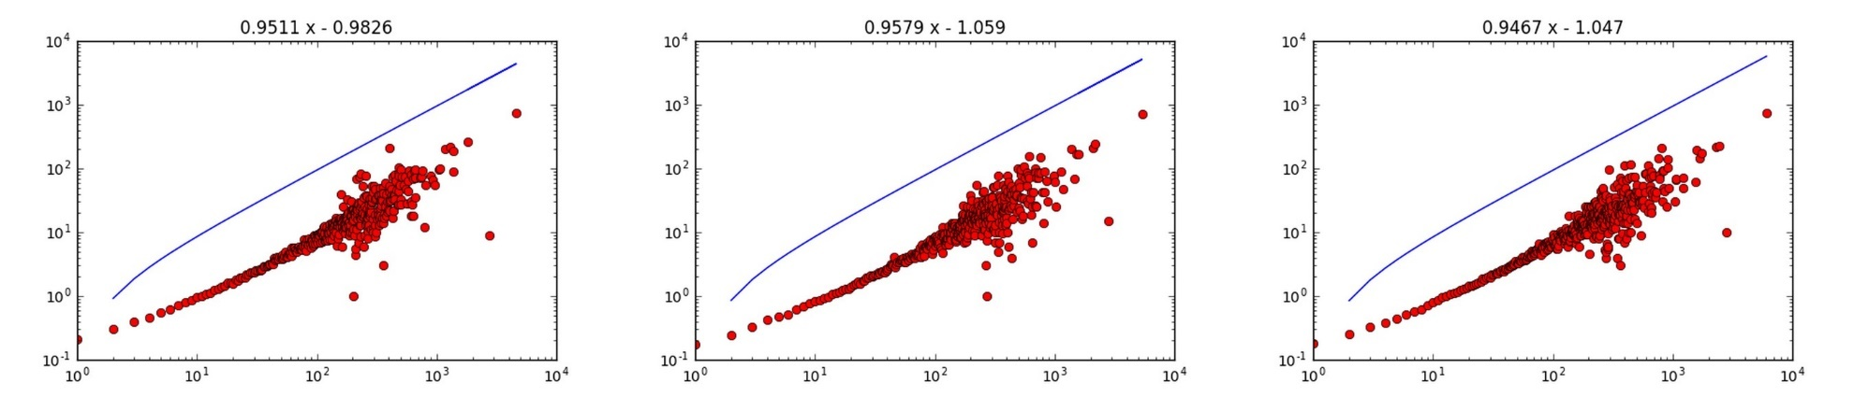
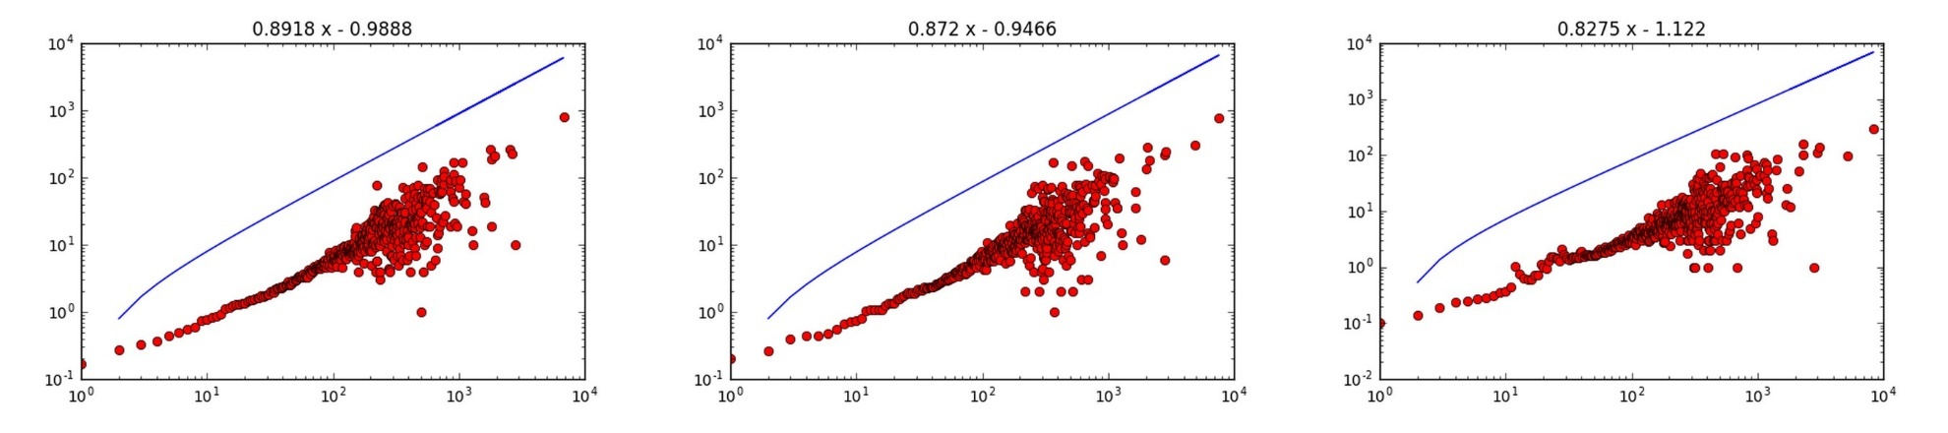
4. Result
Health Professionals
Max:0.957873 (6)
Min.:0.827461 (9)
Avg.: 0.907843 (8)
2010 2011 2012
2013 2014 2015

Slide 31
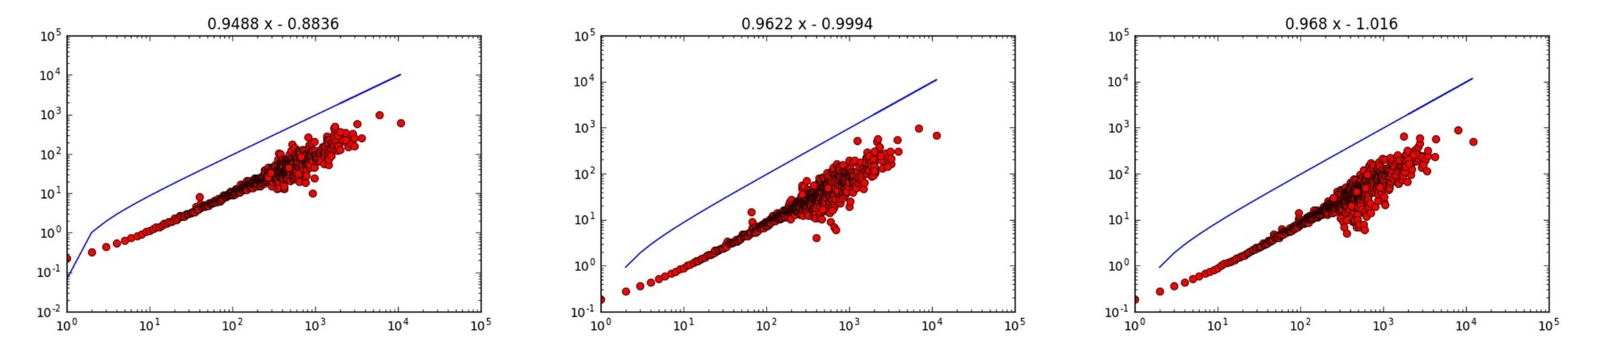
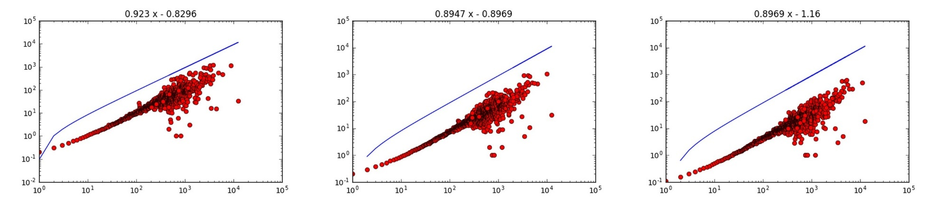
4. Result
Social Sciences
Max:0.967981 (4)
Min.:0.894682 (6)
Avg.: 0.932249 (5)
2010 2011 2012
2013 2014 2015

Slide 32
4. Result
http://Juyoung228.cafe24.com/NS.html
Notes:
일단 설명
동그라미/ 전체적으로 변하는 것. (디그리 색깔)
심하게 왔다 갔다 하는 것. (고유 색깔)/ Earth Science, Health Professionals, math & Physics
막대기/ 각 분야 간의 대결
(나중을 보여주고, 이게 예전엔 어땠는 지)
그래프/ 전체적인 크기

Slide 33
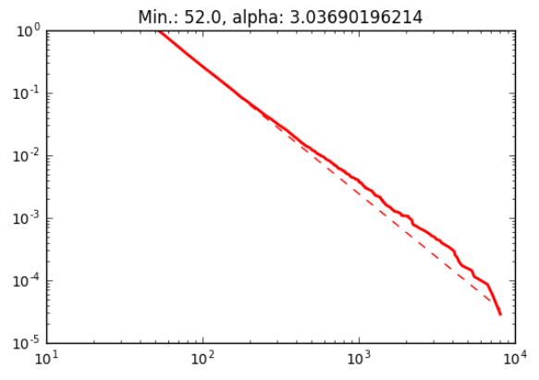
Number of nodes:
1,605,059
Number of edges: 13,987,730
Average in degree:
8.7148
Max:0.974056
Min.:0.914361
Avg.: 0.956942
Biology

Slide 34
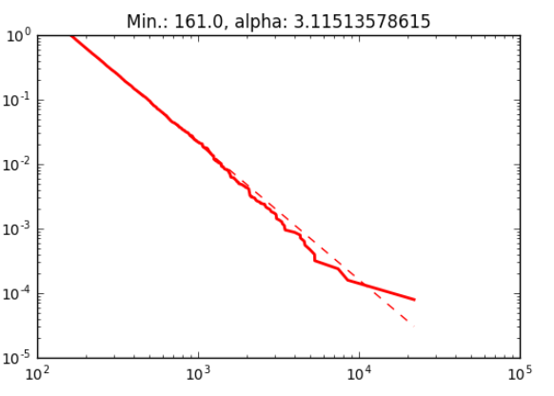
4. Result
Number of nodes:
3,953,726
Number of edges: 36,956,124
Average in degree:
9.3472
Max:0.952849
Min.:0.897082
Avg.: 0.93035
Medical Specialties

Slide 35
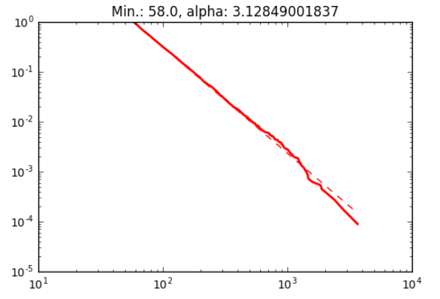
4. Result
Max:0.902967
Min.:0.865482
Avg.: 0.883899
Number of nodes:
1,520,267
Number of edges: 8,279,832
Average in degree:
5.4463
Chemical, Mechanical, & Civil Engineering

Slide 36
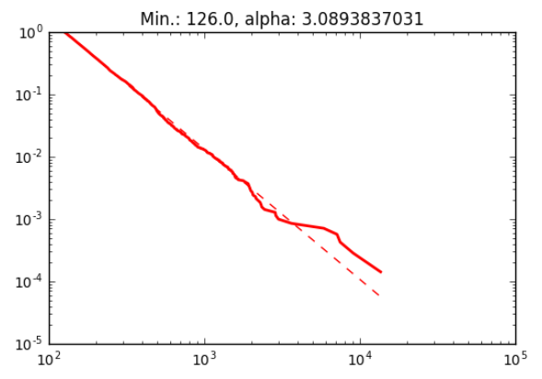
4. Result
Number of nodes:
1,348,819
Number of edges: 13,196,304
Average in degree:
9.7836
Max:0.967981
Min.:0.894682
Avg.: 0.932249
Brain Research

Slide 37
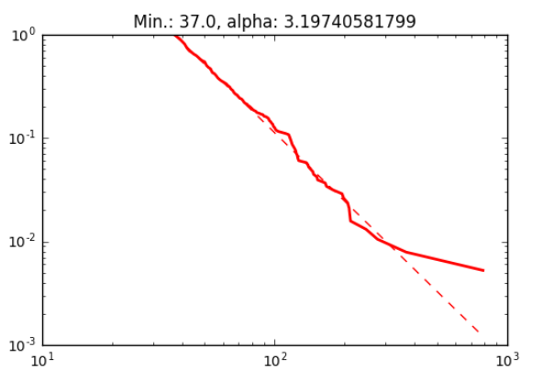
4. Result
Humanities
Number of nodes:
111,869
Number of edges: 209,800
Average in degree:
1.8754
Max:0.967981
Min.:0.894682
Avg.: 0.932249

Slide 38
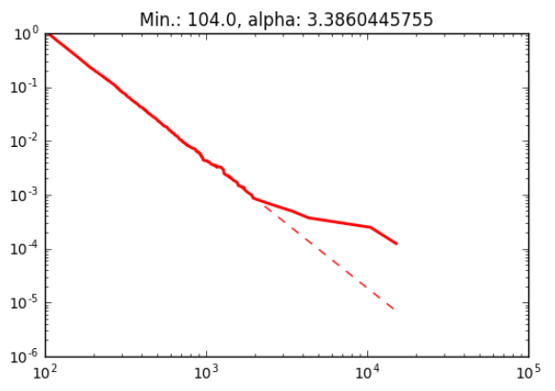
4. Result
Max:0.826846
Min.:0.809136
Avg.: 0.821863
Number of nodes:
1,713,152
Number of edges: 13,841,277
Average in degree:
8.0794
Infectious Diseases

Slide 39
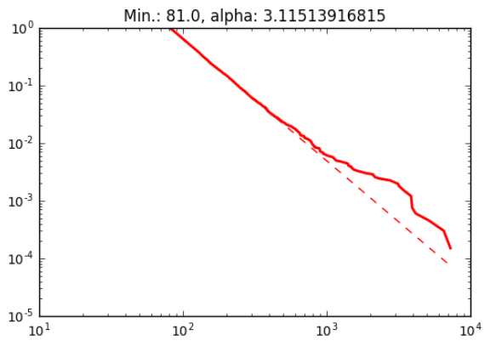
4. Result
Max:0.972602
Min.:0.815953
Avg.: 0.901407
Number of nodes:
1,879,818
Number of edges: 8,403,309
Average in degree:
4.4703
Math & Physics

Slide 40
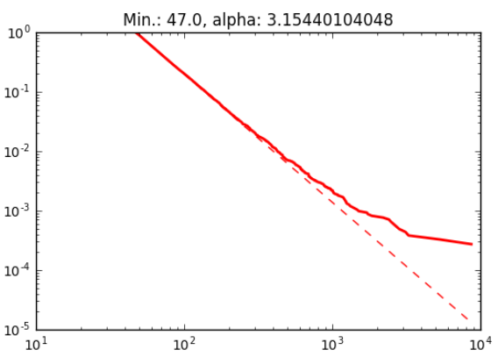
4. Result
Max:0.957873
Min.:0.827461
Avg.: 0.907843
Number of nodes:
1,582,011
Number of edges: 8,843,920
Average in degree:
5.5903
Health Professionals

Slide 41
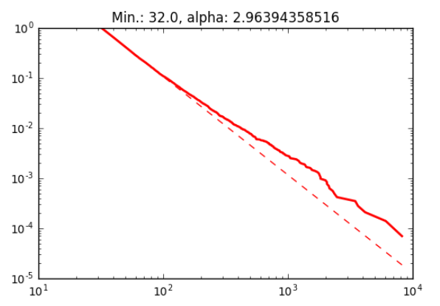
4. Result
Max:0.872838
Min.:0.791954
Avg.: 0.837223
Number of nodes:
649,581
Number of edges: 3,754,640
Average in degree:
5.7801
Biotechnology

Slide 42
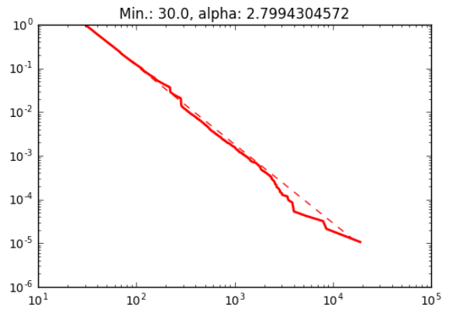
4. Result
Number of nodes:
2,624,852
Number of edges: 17,986,963
Average in degree:
6.8526
Max:0.96017
Min.:0.919899
Avg.: 0.942862
Chemistry

Slide 43
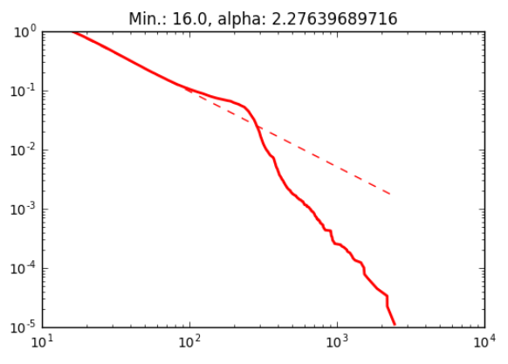
4. Result
Number of nodes:
550,810
Number of edges: 6,502,807
Average in degree:
11.8059
Max:0.91681
Min.:0.781855
Avg.: 0.876991
Earth Sciences

Slide 44
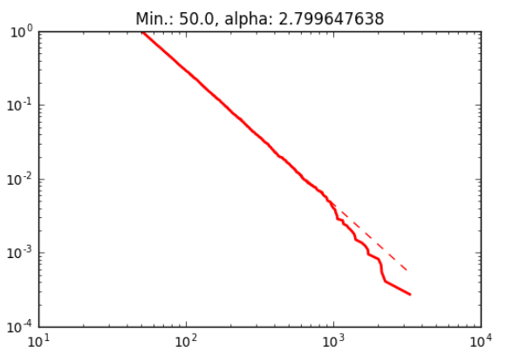
4. Result
Max:0.938529
Min.:0.908403
Avg.: 0.922126
Number of nodes:
868,820
Number of edges: 3,912,001
Average in degree:
4.5027
Electrical Engineering & Computer Science

Slide 45
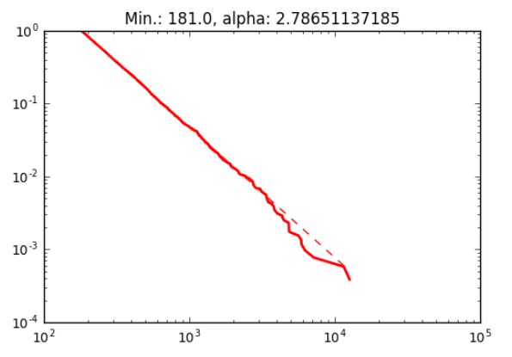
4. Result
Max:0.967981
Min.:0.894682
Avg.: 0.932249
Number of nodes:
1,624,238
Number of edges: 13,188,017
Average in degree:
8.1195
Social Sciences

Slide 46
5. Discussion
Age of a paper
Sleeping beauty
publication that received very little attention (and got few citations) shortly after publication, but later got much attention and many citations. (Wikipedia)
power law distribution of degree, linear preferential attachment of new links and a negative correlation between the age of a node and its link attachment rate.
Klemm, K., & Eguiluz, V. M. (2002, p.1)
Notes:
When you see the loglog plot of preferential attachment , you can see much noise and there is much noise in degree distributions, too.
It means that there are some other features which affect on the formation of citation.
For example, there are some works that proved the age of paper. In short, as time goes by, the probability a node can be cited get decreased.
In addition, there are some papers called as sleeping beauty.
It means that a work which has not been popular, but get popular suddenly, at once.
To understand citation network of multiple disciplines, such other features should be considered in the future study.

Slide 47
Who is the winner?
Yi bu: Humanists tend to cite highly-cited works.
Juyoung An: Computer scientists do not tend to.
Yi bu: Computer scientists also tend to cite highly-cited works.
Juyoung An: At least, they are not that much strongly doing that.
Juyoung An: In addition, as time goes by, the tendency becomes weak
Yi bu: I don’t think so.
http://Juyoung228.cafe24.com/NS.html
Notes:
So, here is the important conclusion.
These are assertions made by me and Yi bu.
Let’s check it!

Slide 48
Who is the winner?
Yi bu: Humanists tend to cite highly-cited works.
Juyoung An: Computer scientists do not tend to.
Yi bu: Computer scientists also tend to cite highly-cited works.
Juyoung An: At least, they are not that much strongly doing that compared to Humanists.
Juyoung An: In addition, as time goes by, the tendency becomes weak
Yi bu: I don’t think so.
☺ Yi-bu is the winner!

Slide 49
References
Börner, K., Klavans, R., Patek, M., Zoss, A. M., Biberstine, J. R., Light, R. P., Lariviere, V., & Boyack, K. W. (2012). Design and update of a classification system: The UCSD map of science. PloS one, 7(7), e39464.
Jeong, H., Néda, Z., & Barabási, A. L. (2003). Measuring preferential attachment in evolving networks. EPL (Europhysics Letters), 61(4), 567.
Newman, M. E. (2001). Clustering and preferential attachment in growing networks. Physical Review E, 64(2), 025102.
Wang, M., Yu, G., & Yu, D. (2008). Measuring the preferential attachment mechanism in citation networks. Physica A: Statistical Mechanics and its Application, 387(18), 4692-4698.
Wang, M., Yu, G., & Yu, D. (2009). Effect of the age of papers on the preferential attachment in citation networks. Physica A: Statistical Mechanics and its Applications, 388(19), 4273-4276.
Wang, D., Song, C., & Barabási, A. L. (2013). Quantifying long-term scientific impact. Science, 342(6154), 127-132.
Barabási, A. L., & Albert, R. (1999). Emergence of scaling in random networks. science, 286(5439), 509-512.

Slide 50
References
Arnab Sinha, Zhihong Shen, Yang Song, Hao Ma, Darrin Eide, Bo-June (Paul) Hsu, and Kuansan Wang. 2015. An Overview of Microsoft Academic Service (MAS) and Applications. In Proceedings of the 24th International Conference on World Wide Web (WWW ’15 Companion). ACM, New York, NY, USA, 243-246. DOI=http://dx.doi.org/10.1145/2740908.2742839
Milojević, S. (2010). Modes of collaboration in modern science: Beyond power laws and preferential attachment. Journal of the Association for Information Science and Technology, 61(7), 1410-1423
Klemm, K., & Eguiluz, V. M. (2002). Highly clustered scale-free networks. Physical Review E, 65(3), 036123.
Medina, C., & Leeuwen, T. N. (2012). Seed journal citation network maps: A method based on network theory. Journal of the American Society for Information Science and Technology, 63(6), 1226-1234.
Radev, D. R., Joseph, M. T., Gibson, B., & Muthukrishnan, P. (2009). A bibliometric and network analysis of the field of computational linguistics. Journal of the American Society for Information Science and Technology, 1001, 48109-1092.
Peterson, G. J., Pressé, S., & Dill, K. A. (2010). Nonuniversal power law scaling in the probability distribution of scientific citations. Proceedings of the National Academy of Sciences, 107(37), 16023-16027.

Slide 51
References
Redner, S. (1998). How popular is your paper? An empirical study of the citation distribution. The European Physical Journal B-Condensed Matter and Complex Systems, 4(2), 131-134.

Slide 52
Thank you so much!
Juyoung An & Yi Bu
School of Informatics and Computing, Indiana University

